Slide 1
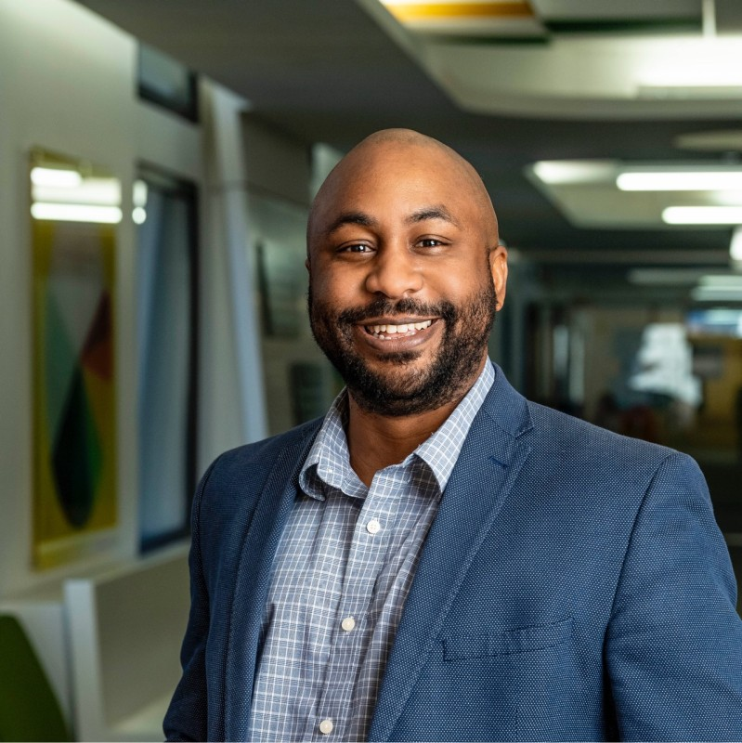
Influential Leader
Emanuel O. Clayton, Ph.D.
Assistant Director – Academic Success
Student Success Center
Wright State University
Tutor Supervisor – Math Learning Center
Notes:
The influential leader I selected for this presentation is Dr. Emanuel Clayton, Assistant Director of Academic Success at Wright State University. I first met Dr. Clayton in the summer of 2024, and I began working with him in Spring 2025 as a tutor at the Math Learning Center. In his role, he leads academic support programs and supervises tutors who help students improve their mathematics skills. I chose Dr. Clayton because his leadership focuses on helping students who struggle with math build strong foundational knowledge and become independent learners. Through his guidance and training, tutors like me learn how to support students effectively and communicate professionally.

Slide 2
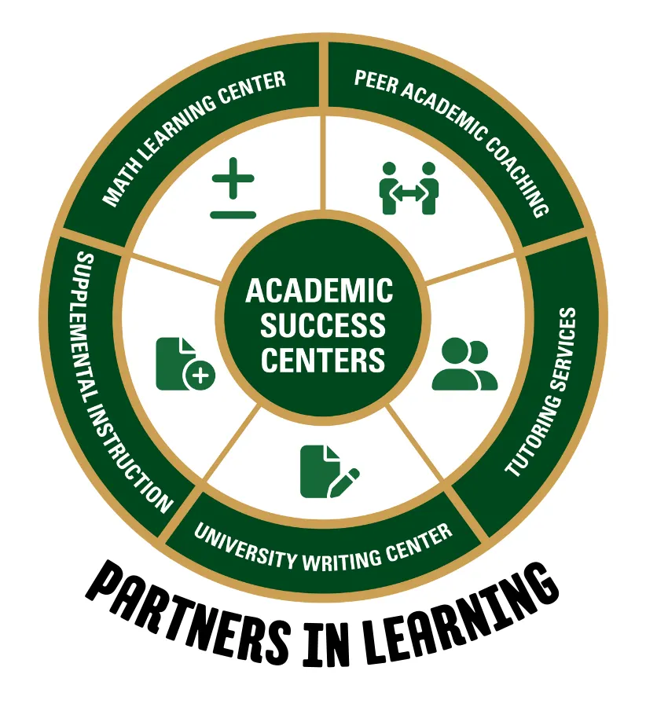
Leadership Strength – Sociability
Strength: Sociability
Builds positive relationships
Encourages tutors and students
Creates a supportive learning environment
Reference: (Northouse, 2025)
Notes:
One leadership strength that describes Dr. Clayton is sociability. According to Northouse, sociability refers to a leader’s ability to build positive relationships and communicate effectively with others. Dr. Clayton demonstrates this strength through the way he interacts with tutors and students in the Math Learning Center. He encourages tutors to be patient and supportive when helping students solve math problems. Even when students make mistakes, he responds with encouragement and a positive attitude. This creates a comfortable learning environment where students feel confident asking questions and improving their skills. The image represents the academic success services that support collaboration and learning at Wright State University.

Slide 3
Implements Vision
Vision: Student Independence in Mathematics
Strengthen foundational math skills
Train tutors to guide students
Support learning online and in person
Reference: (Northouse, 2025)
Notes:
Dr. Clayton demonstrates leadership by implementing a vision for student success. According to Northouse, implementing a vision means turning ideas into real actions that benefit the organization. Dr. Clayton’s vision focuses on helping students develop strong math foundations so they can become independent learners. He implements this vision by hiring skilled tutors and training them to guide students through problem-solving rather than simply giving answers. Tutoring sessions are offered both online and face-to-face to support different learning needs. Through these efforts, students gain confidence and improve their understanding of mathematics.

Slide 4
References
Northouse, P. G. (2025). Introduction to leadership: Concepts and practice (6th ed.). Sage Publications.
Clayton, E. O. (2026). Wright State University profile. https://people.wright.edu/emanuel.clayton

